Slide 1


Highway Help
Presented By-
Prashant .S.Sutar(233102)
Suraj.S.Kadam(233100)

Slide 2
Project Introduction
The Highway-Help project is a collaborative effort to create a secure online platform to provide the helpful services to the users or customers which are in trouble or needy when they are travelling on the highway.
Becuase nowadays we are seeing that in our country amount of night or highway accidents are increasing very rapidly.
The accident place is far from city or village then it is difficult for peoples to get the help immediately.
The Highway-Help project will allow service providers to list their services on an online application.
This will help the users/customers to get benefit of the services.

Slide 3
Objective (Purpose):
The online highway help is a Web Application is intended to provide complete solution for Service provider and Coustmer/user through a single Gateway using internet.
To produce a web-based system that allow the admin to add Services Details and provide functionalities to its role
To ease Service providers by providing different functionalities to it.
To ease customers to help him if he is in trouble or want help on highway.

Slide 4
Scope:
Online highway help System is a web application.
The scope of Highway-Help project would include designing and developing a digital platform that allows customers/users.
The service providers can track the actual location on the map and also we can extend this to the area.
Web-platform means that the system will be available for access 24/7 .
To ease customers to help him if he is in trouble or want help on highway.
The online highway help will be Administrated by Admin.

Slide 5
Technology Used:
Front End: ReactJS
Back End: Java Spring Boot API.
Database: MySQL

Slide 6
S/W and H/W Requirements
Server Side:
Processor: Intel core i5 or above
HDD: 500 GB or above
RAM: 4GB or above
Database: MySQL
Client Side (minimum requirement):
Processor: Intel Dual Core
HDD: Minimum 80GB Disk Space
RAM: Minimum 2GB
OS: Windows 7, Linux

Slide 7
Functionalities - Module wise /user wise
Online Mess Service Portal consists of three modules named below
1. Admin
2. Customer/User
User Roles:
Admin : Admin can login to the system.
Admin:login,add services,add services details, update services.
Customer : register itself, logins ,update her/his details,view services,book servies.

Slide 8
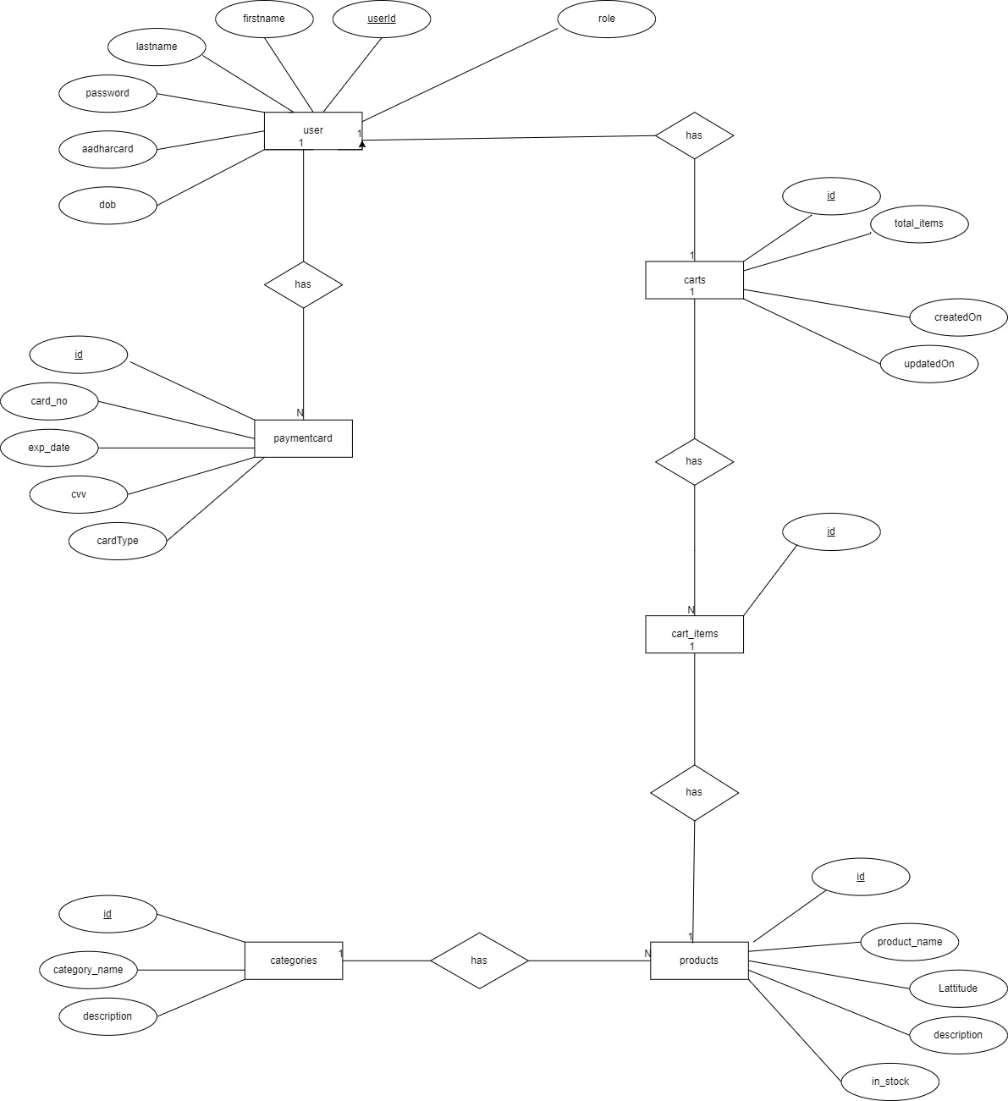
UML Diagrams: E-R Diagram

Slide 9
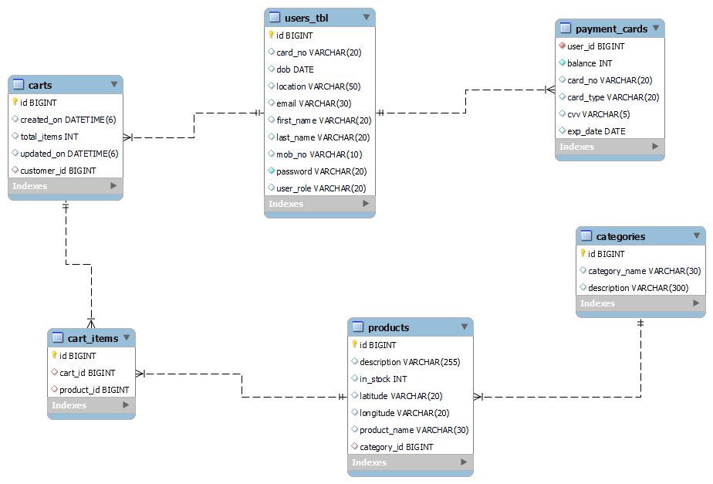
Class Diagram(MySQL Auto generated)

Slide 10
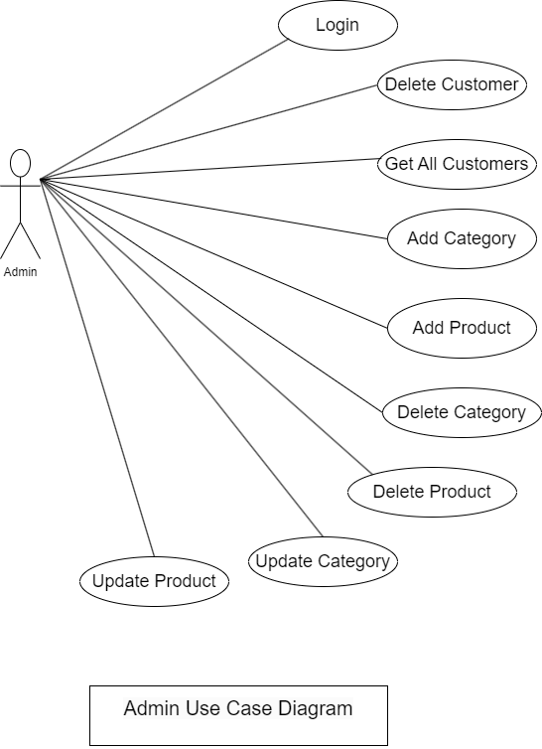
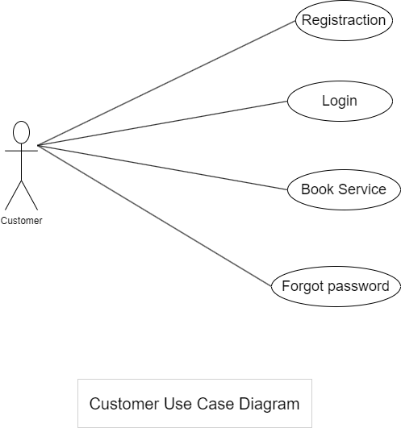
Use Case

Slide 11
Activity Diagram Of Admin

Slide 12
Activity Diagram Of Customer

Slide 13
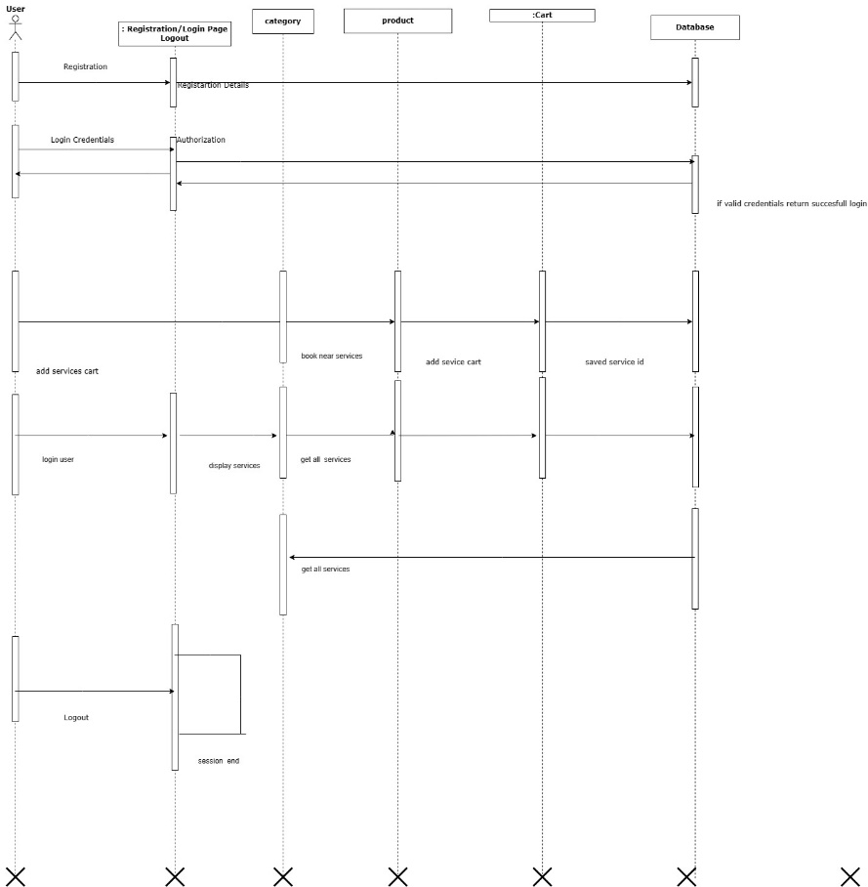
sequence diagram for login

Slide 14
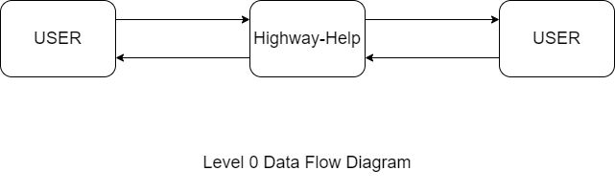
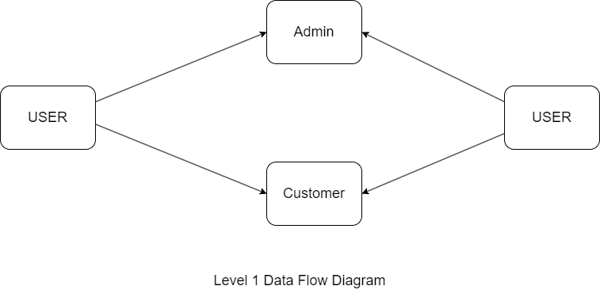
DFD diagrams

Slide 15
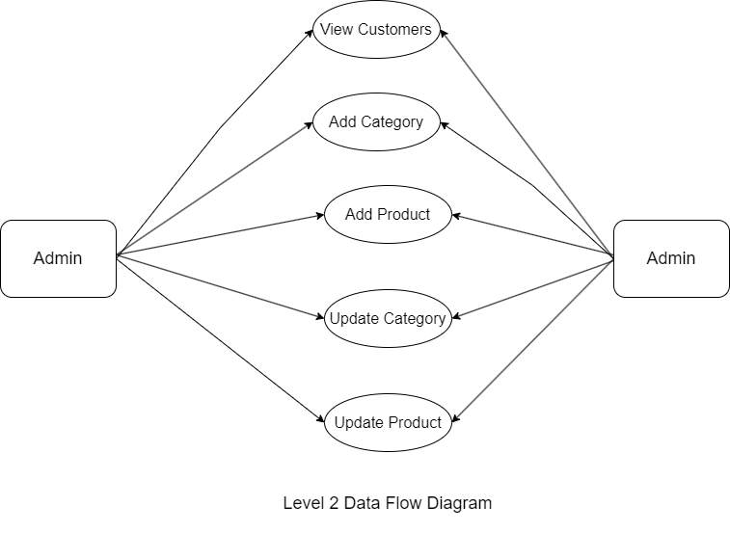
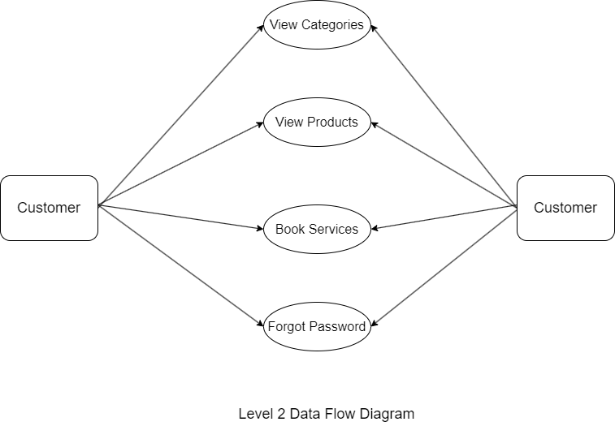

Slide 16
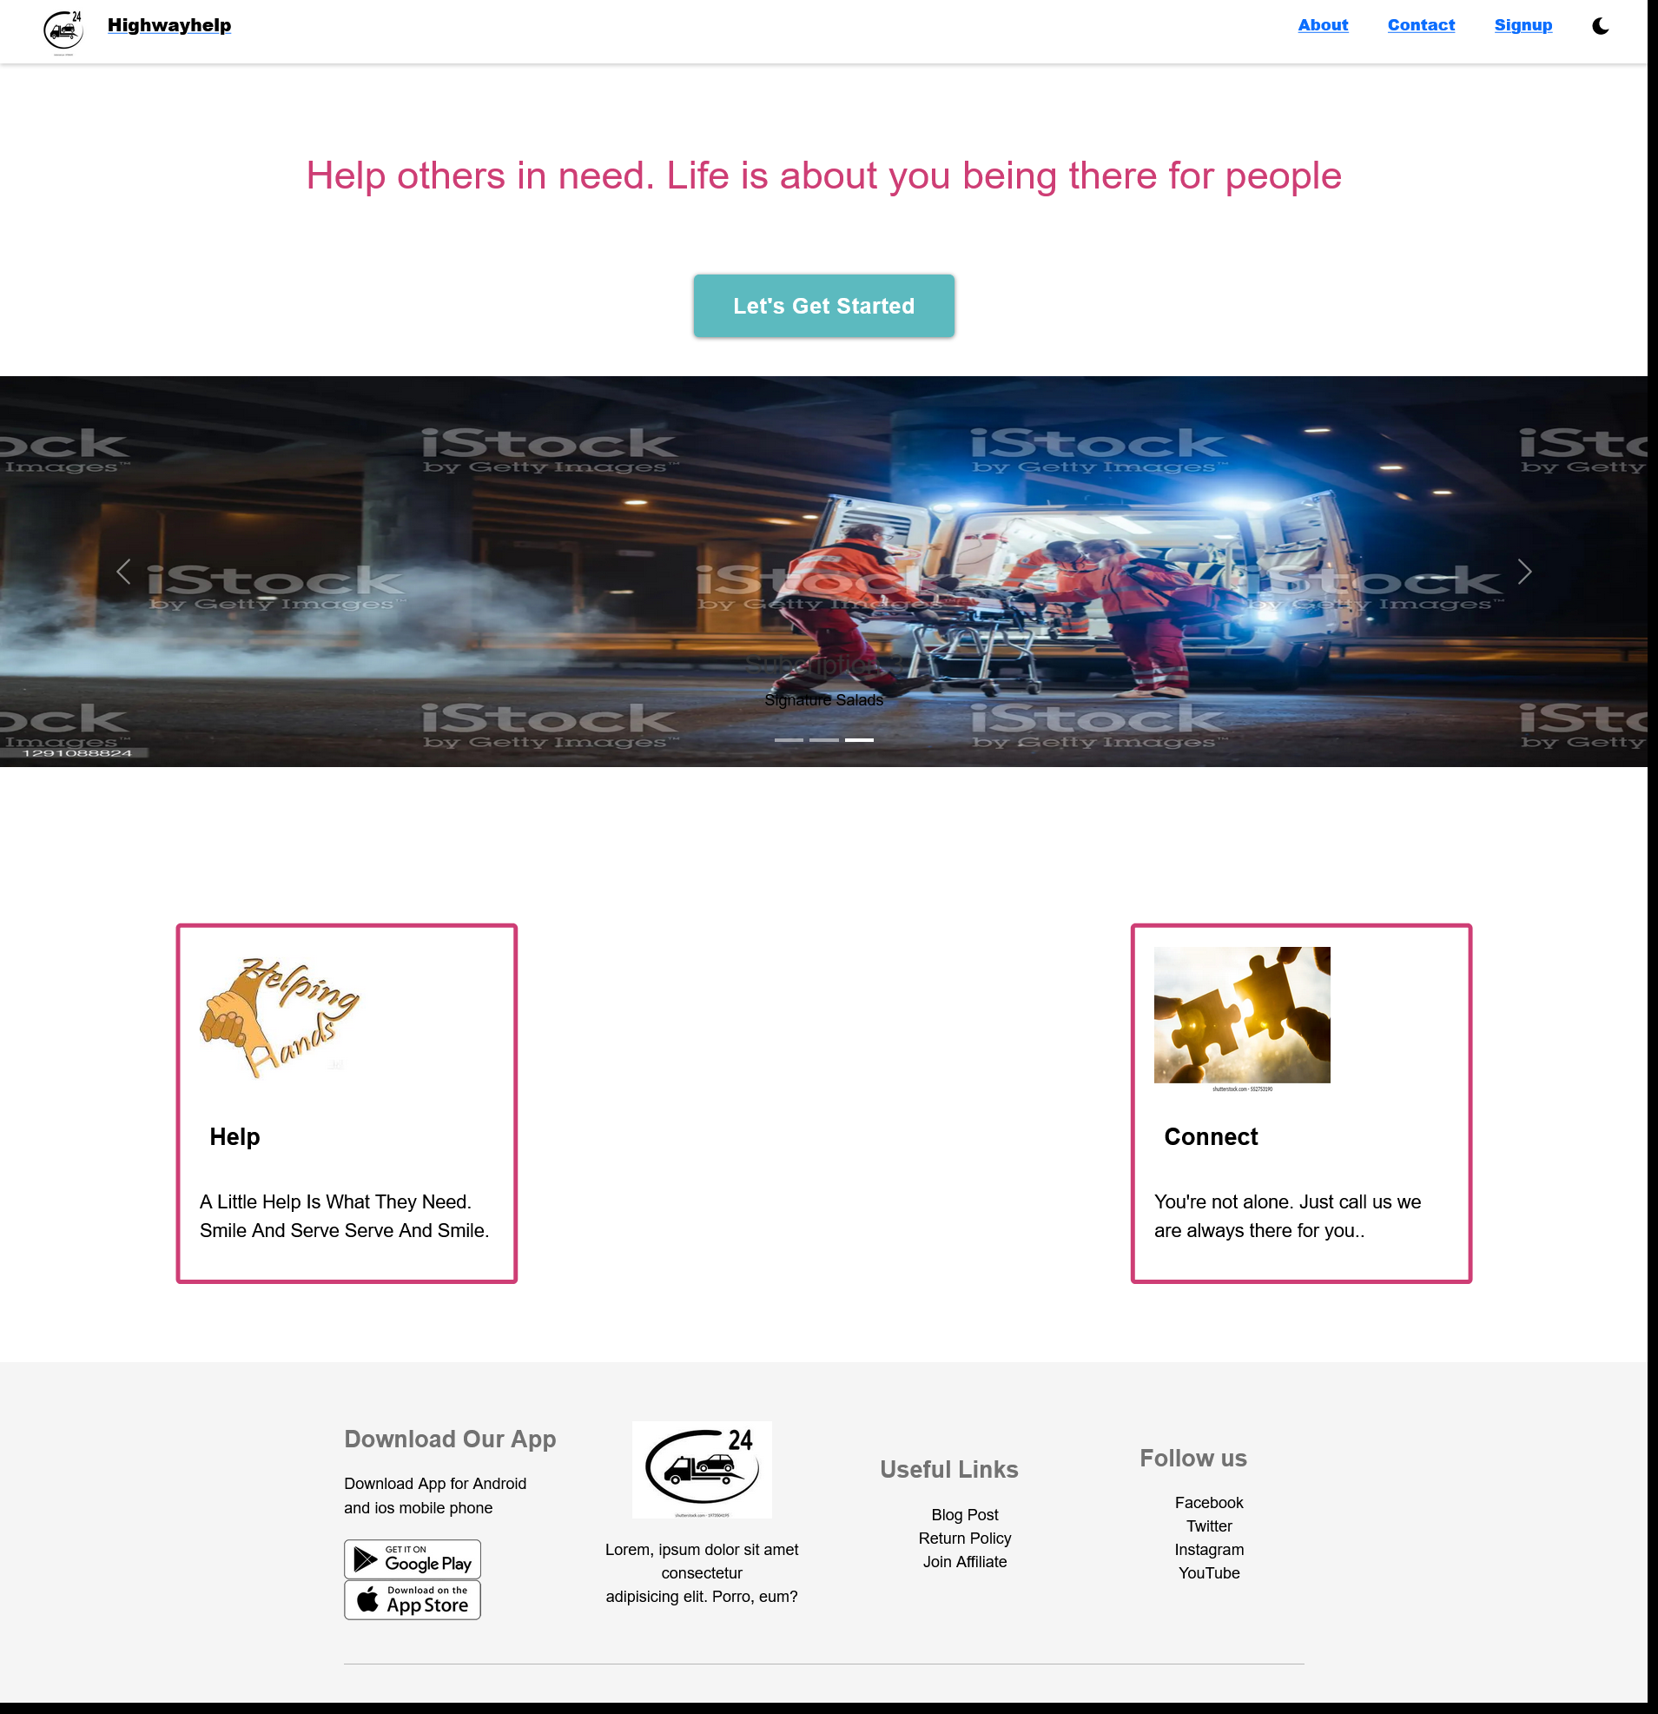
UI Screen Shots

Slide 17
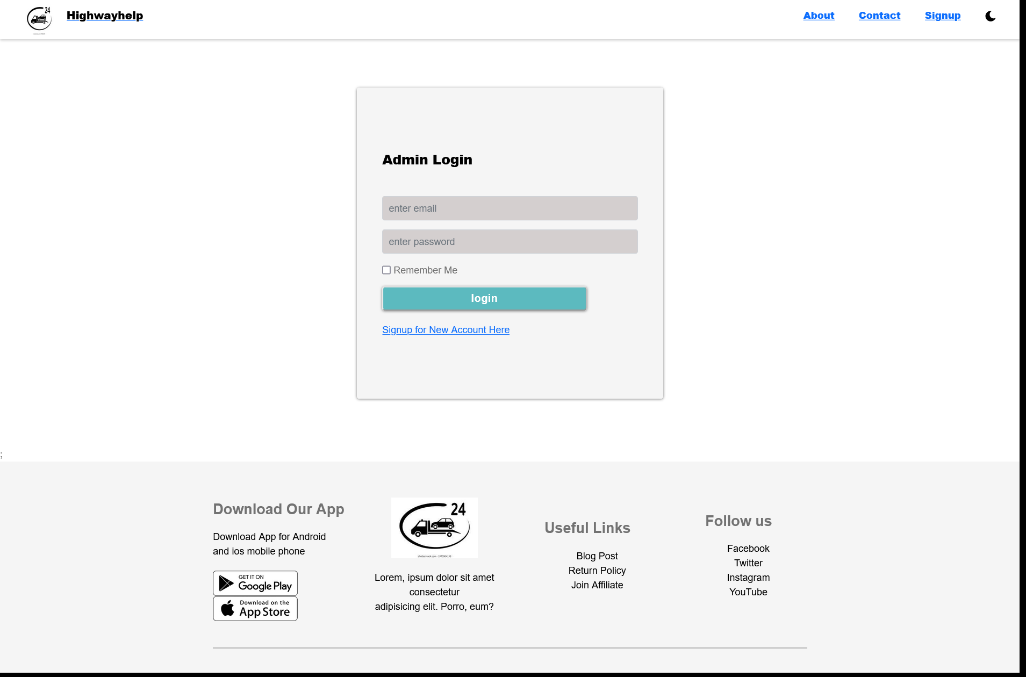
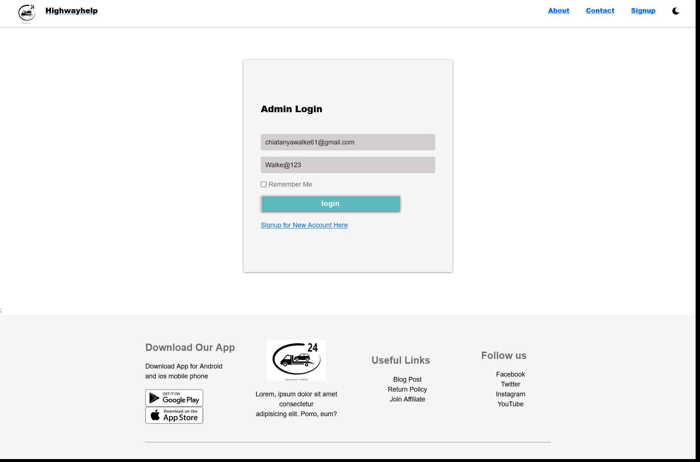
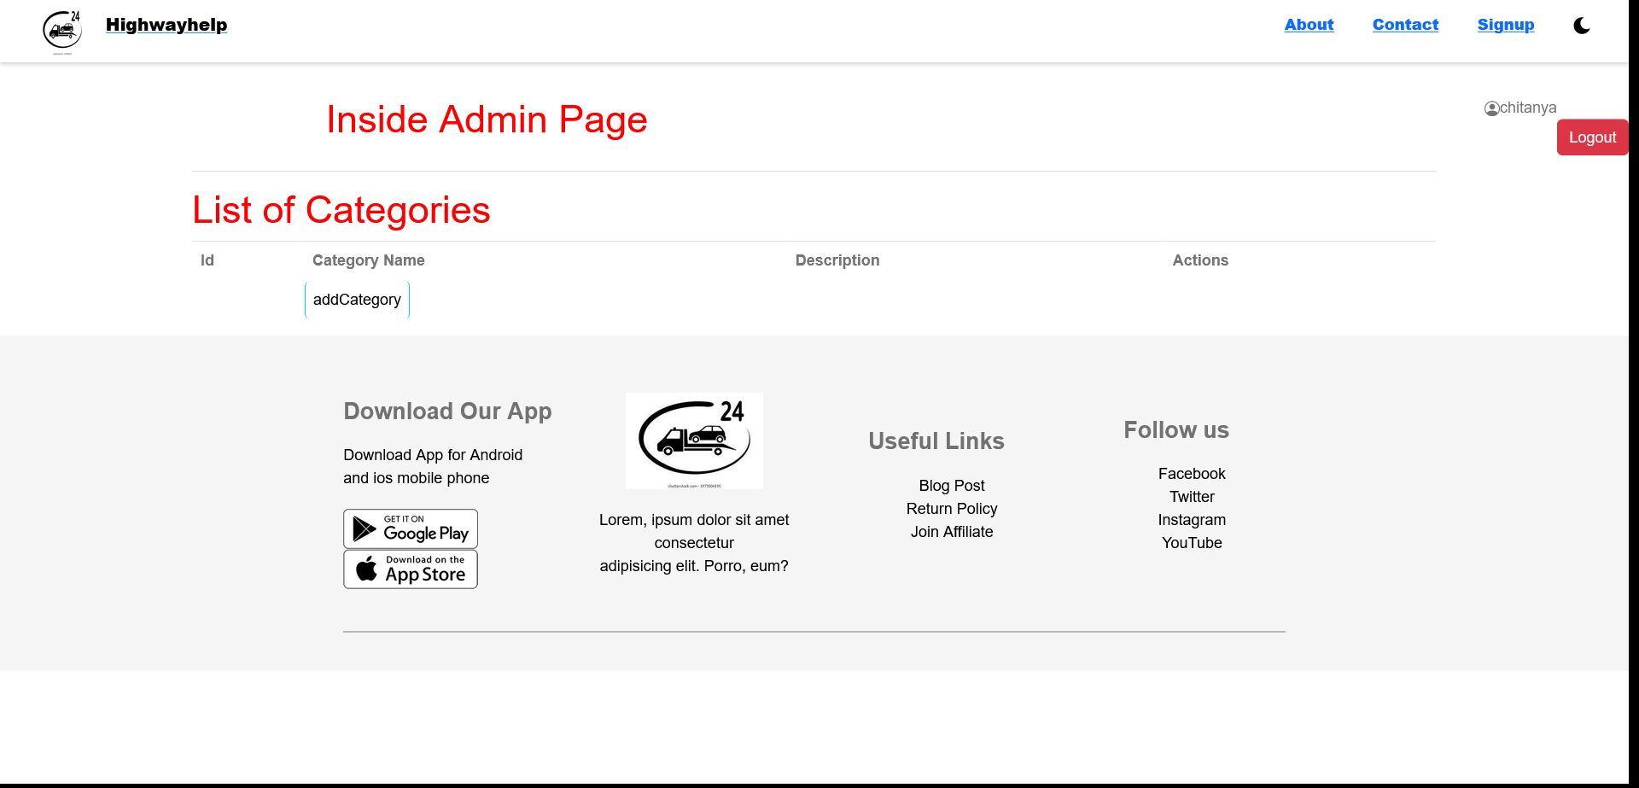
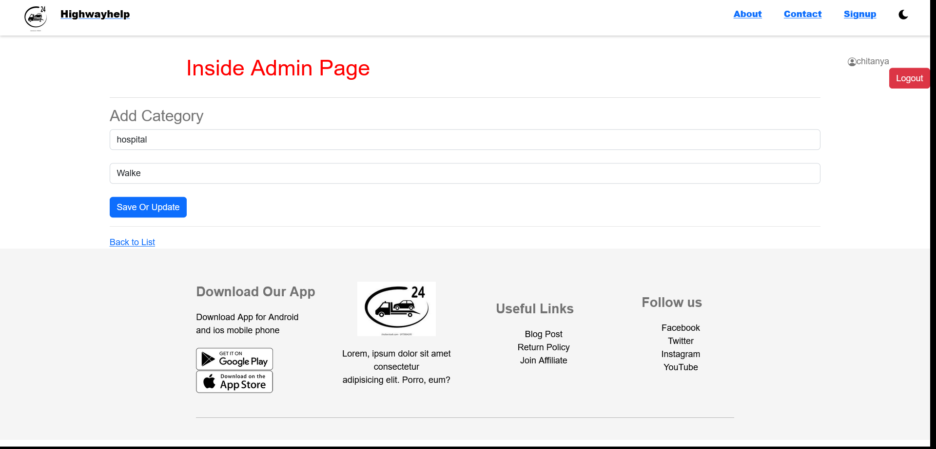

Slide 18
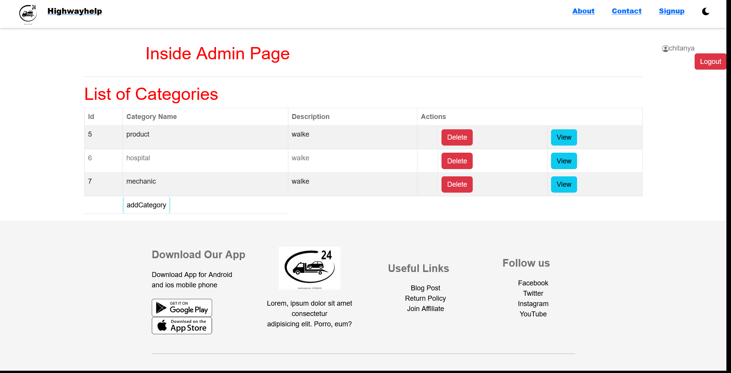
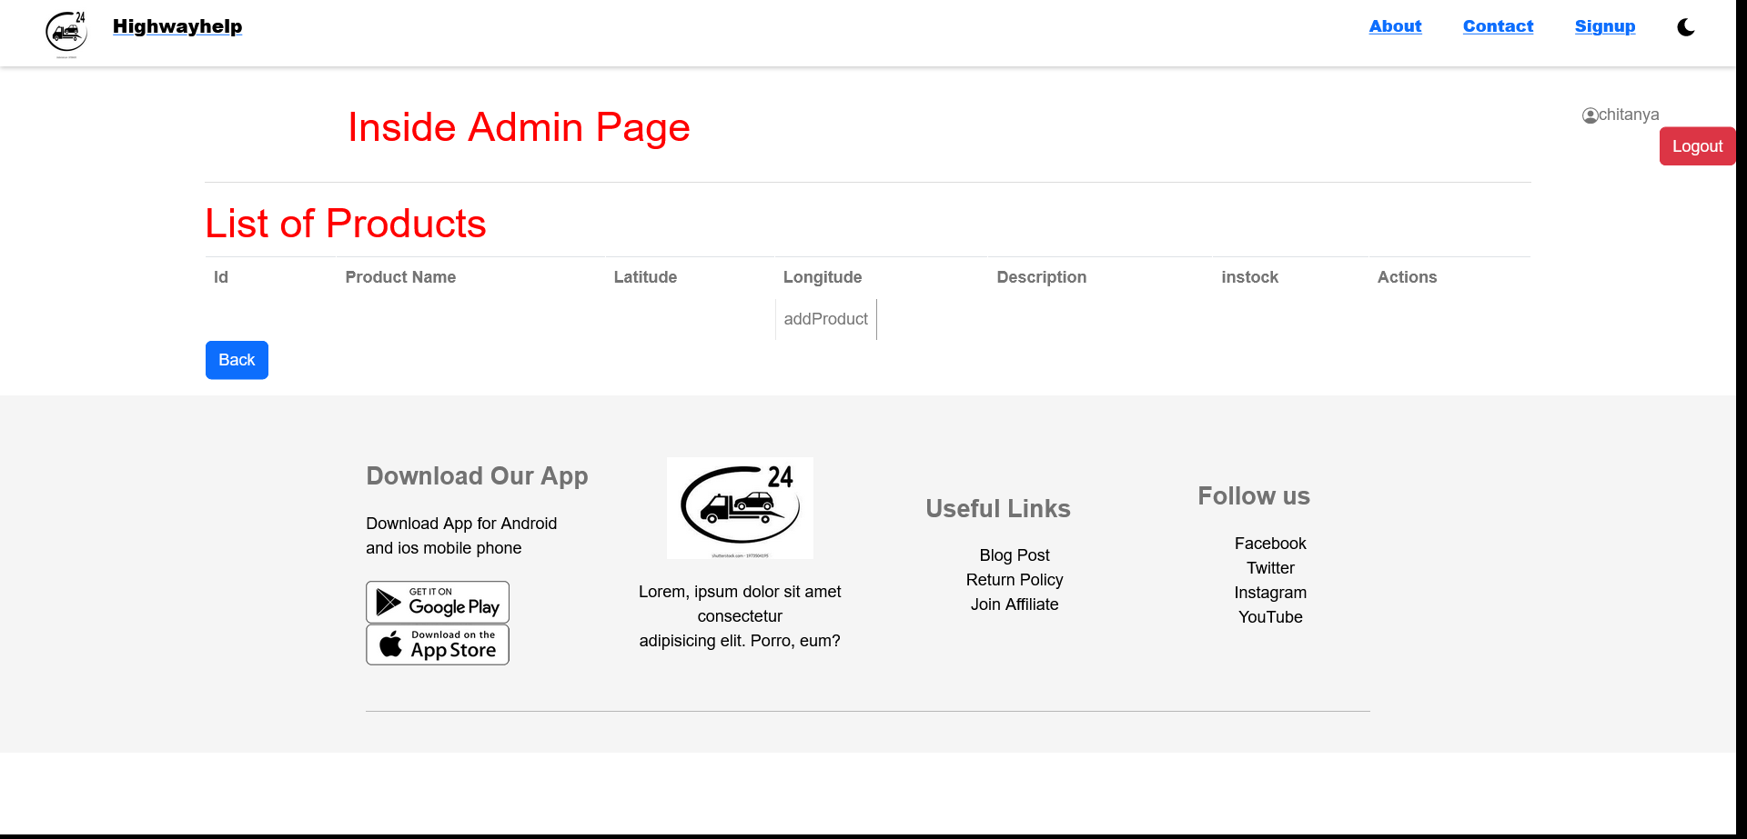
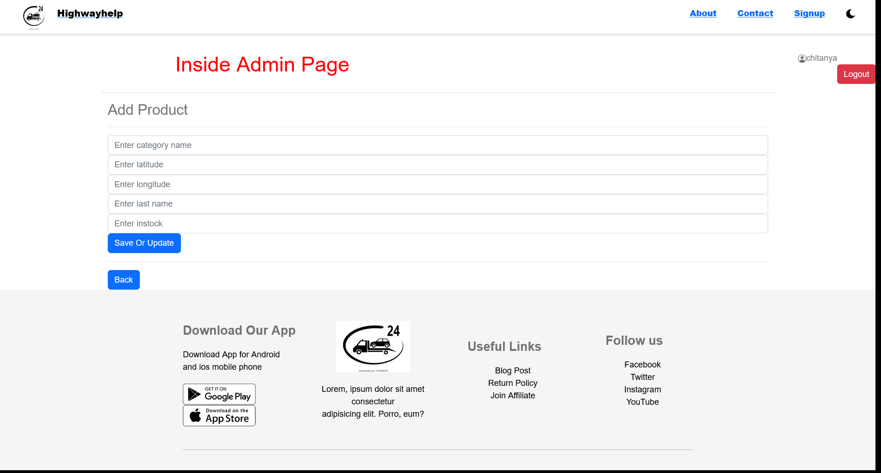
view
Add product
save

Slide 19

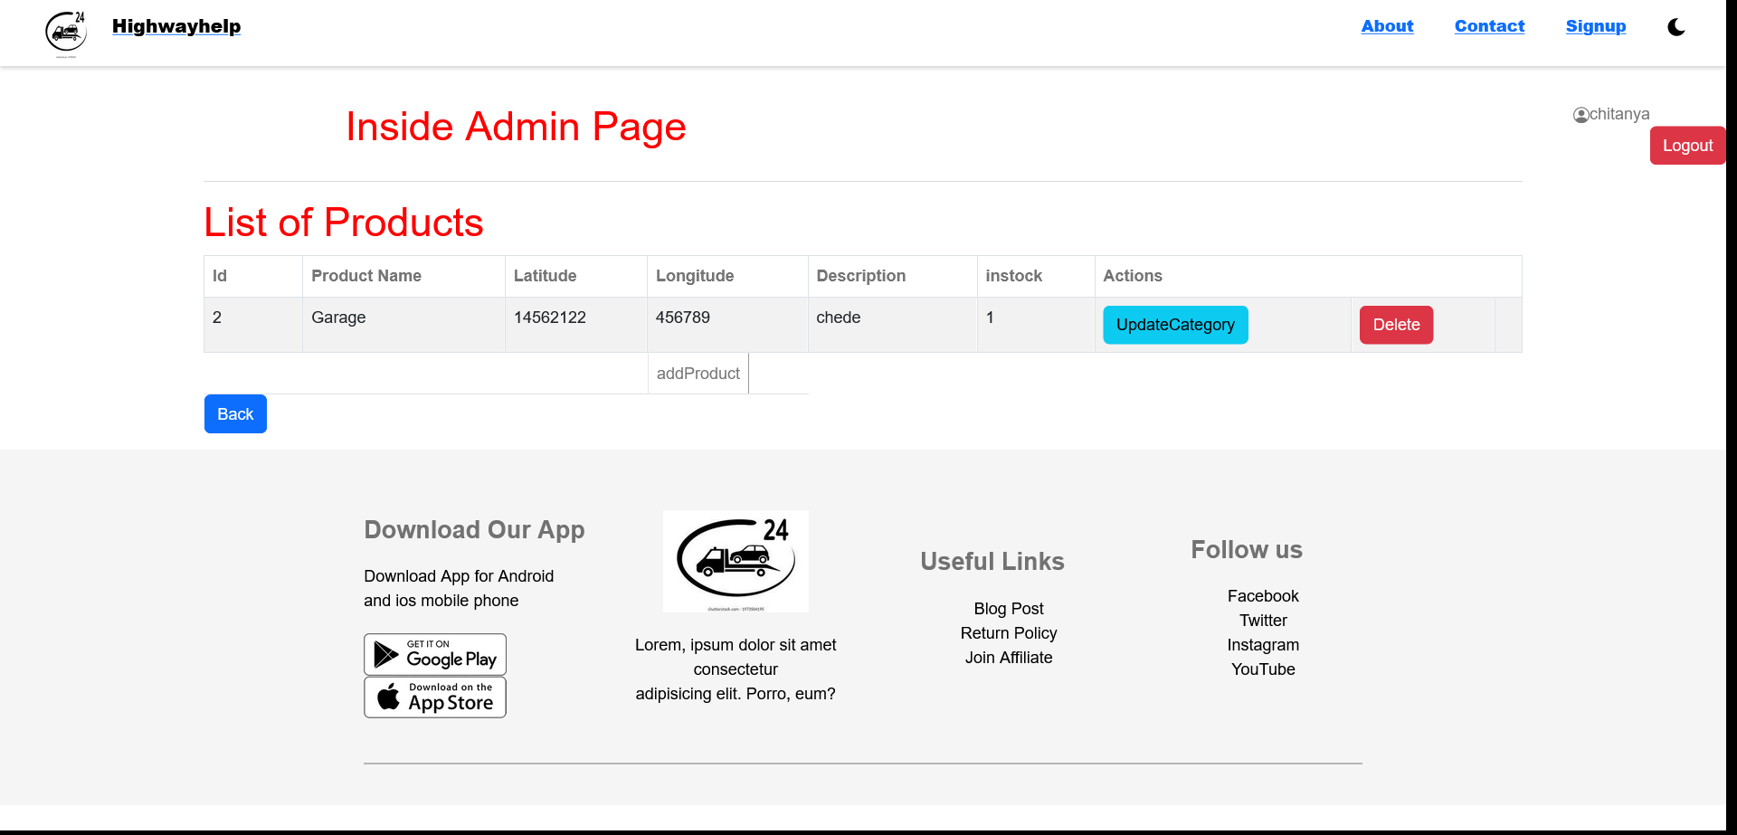
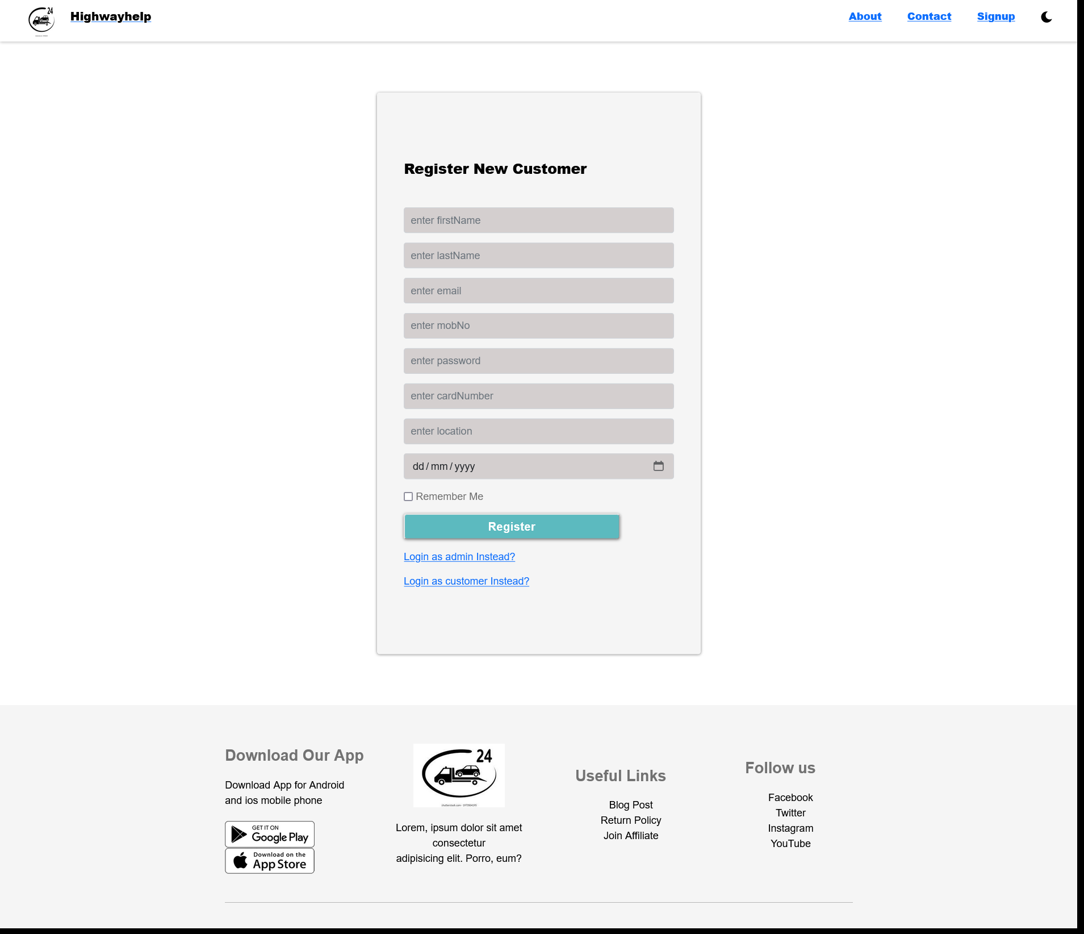
Save or update
delete
Delete product
User register

Slide 20
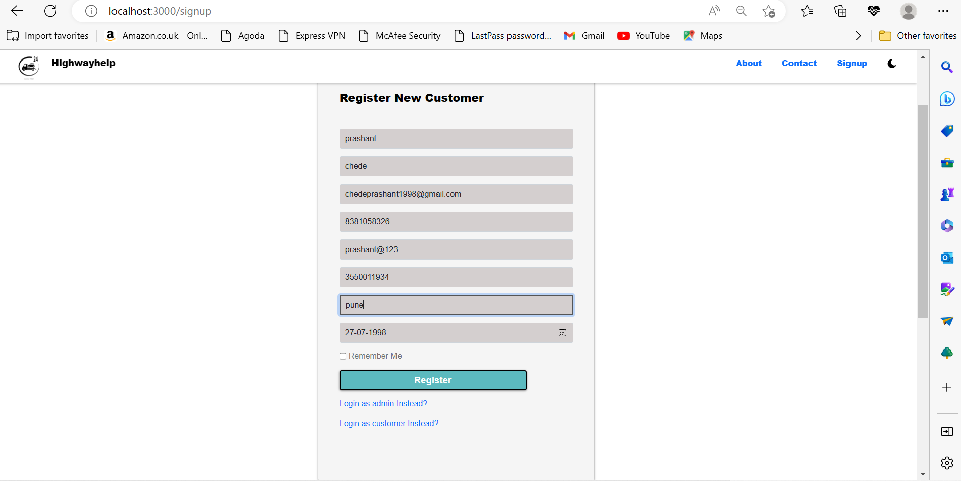
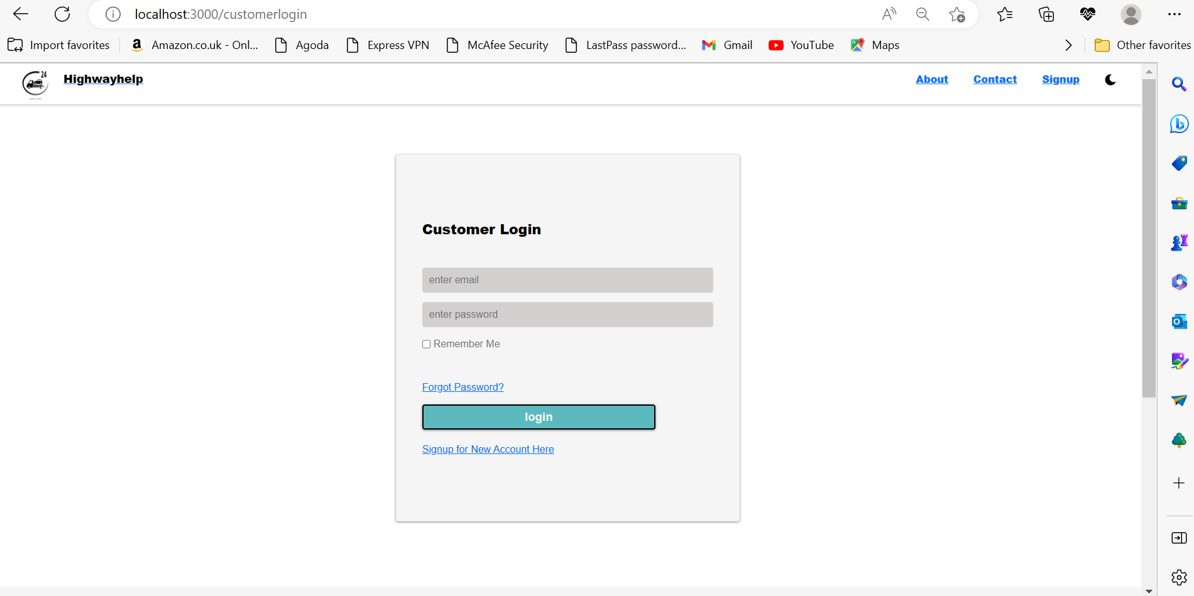
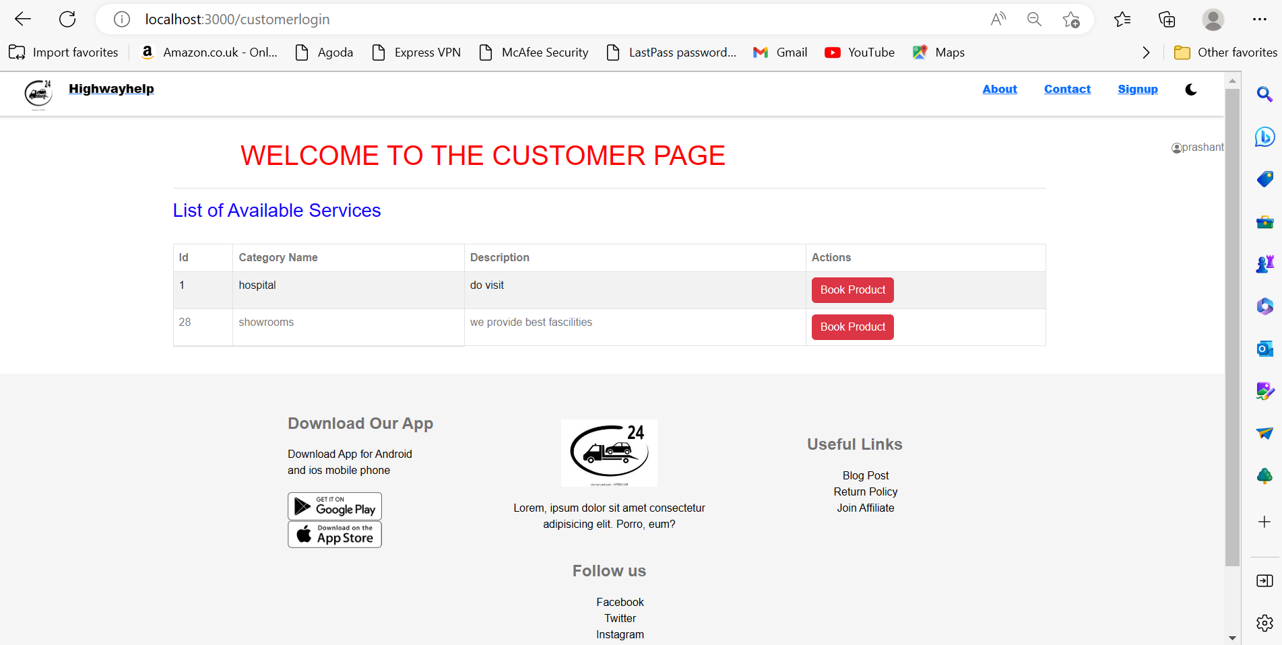
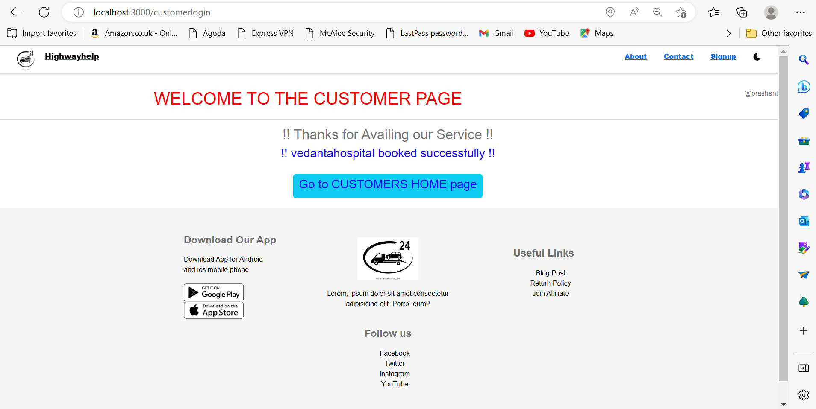
Register
succesfully
login
Book service
Book service

Slide 21
Futures Scope
This project can be enhanced further by adding more fascilities like nearby who tels and their fascilities and also other services.
In this project we have just used geo-location like latitude and longitude but in future we can use real Google map so that user and service providers can track their respective locations.
Also we can extend this service providing fascility over wide area network .

Slide 22
Conclusion
The Highway-Help project is initiative to create an online platform for any user to consume .
the services which are available on the application. So that they will get secure, gauranted and immediate service/help on time.
And also these services will be secure and easily available to any user.

Slide 23
References
https://docs.oracle.com/en/java/
https://docs.spring.io/spring-boot/docs/current/reference/htmlsingle/
https://dev.mysql.com/doc/
https://reactjs.org/
https://ihmcl.co.in/24x7-national-highways-helpline-1033/

Slide 24

THANK YOU

